Slide 1
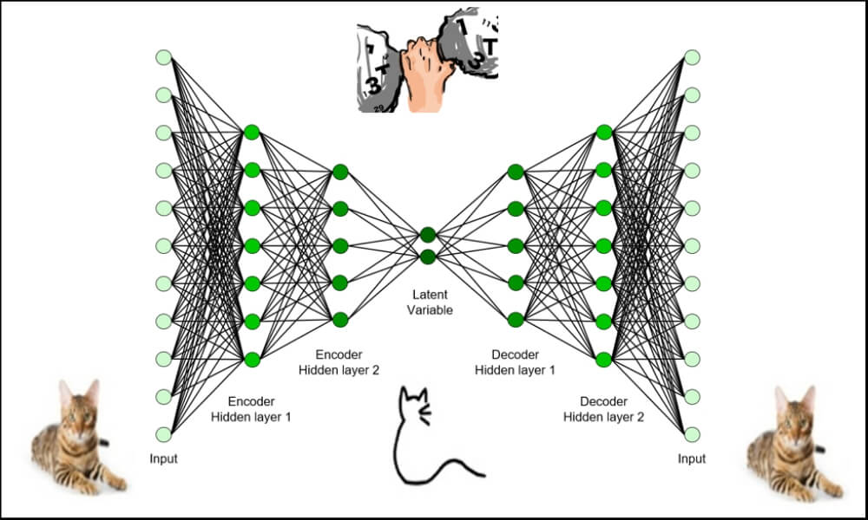
CPSC 4430/5440: Machine Learning Lesson D07: AutoEncoders
Derived from Purdue University

Slide 2
Autoencoders
Supervised learning uses explicit labels/correct output in order to train a network.
E.g., classification of images.
Unsupervised learning relies on data only.
E.g., CBOW and skip-gram word embeddings: the output is determined implicitly from word order in the input data.
Key point is to produce a useful embedding of words.
The embedding encodes structure such as word similarity and some relationships.
Still need to define a loss – this is an implicit supervision.

Slide 3
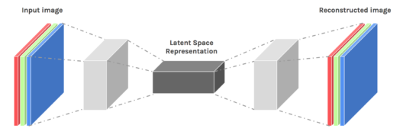
Autoencoders
Autoencoders are designed to reproduce their input, especially for images.
Key point is to reproduce the input from a learned encoding.
https://www.edureka.co/blog/autoencoders-tutorial/

Slide 4
Autoencoders
Compare PCA/SVD
PCA takes a collection of vectors (images) and produces a usually smaller set of vectors that can be used to approximate the input vectors via linear combination.
Very efficient for certain applications.
Fourier and wavelet compression is similar.
Neural network autoencoders
Can learn nonlinear dependencies
Can use convolutional layers
Can use transfer learning
https://www.edureka.co/blog/autoencoders-tutorial/

Slide 5
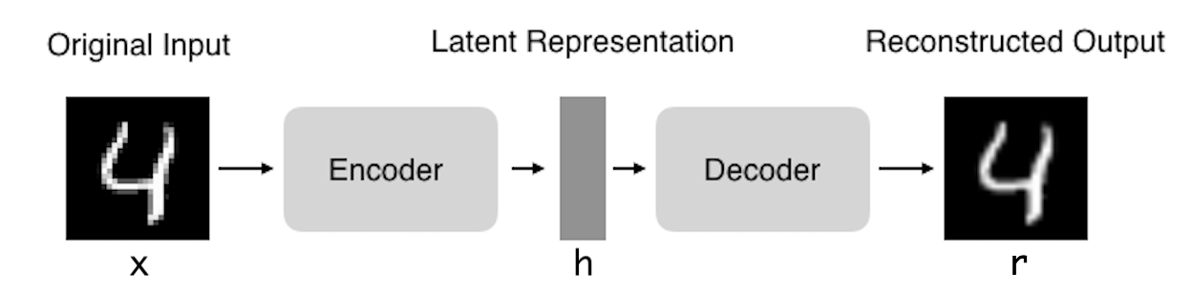
Autoencoders: structure
Encoder: compress input into a latent-space of usually smaller dimension. h = f(x)
Decoder: reconstruct input from the latent space. r = g(f(x)) with r as close to x as possible
https://towardsdatascience.com/deep-inside-autoencoders-7e41f319999f

Slide 6
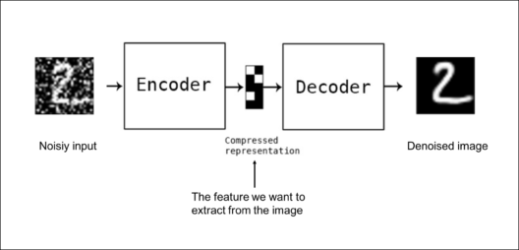
Autoencoders: applications
Denoising: input clean image + noise and train to reproduce the clean image.
https://www.edureka.co/blog/autoencoders-tutorial/

Slide 7
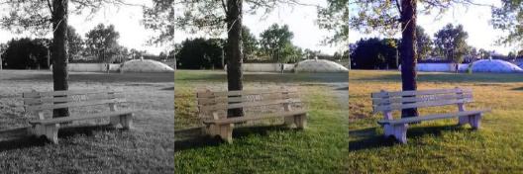
Autoencoders: Applications
Image colorization: input black and white and train to produce color images
https://www.edureka.co/blog/autoencoders-tutorial/

Slide 8
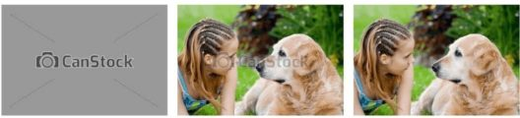
Autoencoders: Applications
Watermark removal
https://www.edureka.co/blog/autoencoders-tutorial/

Slide 9
Properties of Autoencoders
Data-specific: Autoencoders are only able to compress data similar to what they have been trained on.
Lossy: The decompressed outputs will be degraded compared to the original inputs.
Learned automatically from examples: It is easy to train specialized instances of the algorithm that will perform well on a specific type of input.
https://www.edureka.co/blog/autoencoders-tutorial/

Slide 10
Capacity
As with other NNs, overfitting is a problem when capacity is too large for the data.
Autoencoders address this through some combination of:
Bottleneck layer – fewer degrees of freedom than in possible outputs.
Training to denoise.
Sparsity through regularization.
Contractive penalty.

Slide 11
Bottleneck layer (undercomplete)
Suppose input images are nxn and the latent space is m < nxn.
Then the latent space is not sufficient to reproduce all images.
Needs to learn an encoding that captures the important features in training data, sufficient for approximate reconstruction.

Slide 12
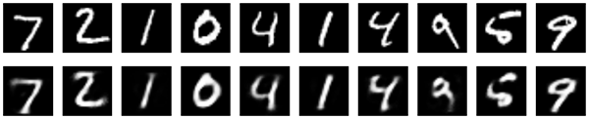
Simple bottleneck layer in Keras
input_img = Input(shape=(784,))
encoding_dim = 32
encoded = Dense(encoding_dim, activation='relu')(input_img)
decoded = Dense(784, activation='sigmoid')(encoded)
autoencoder = Model(input_img, decoded)
Maps 28x28 images into a 32 dimensional vector.
Can also use more layers and/or convolutions.
https://blog.keras.io/building-autoencoders-in-keras.html

Slide 13
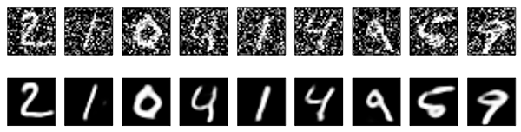
Denoising autoencoders
Basic autoencoder trains to minimize the loss between x and the reconstruction g(f(x)).
Denoising autoencoders train to minimize the loss between x and g(f(x+w)), where w is random noise.
Same possible architectures, different training data.
Kaggle has a dataset on damaged documents.
https://blog.keras.io/building-autoencoders-in-keras.html

Slide 14
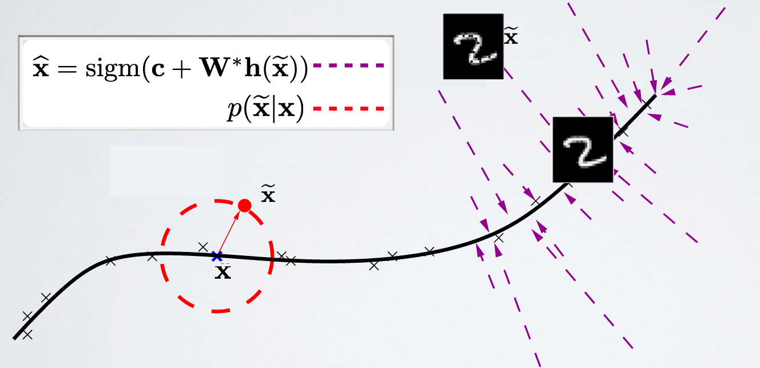
Denoising autoencoders
Denoising autoencoders can’t simply memorize the input output relationship.
Intuitively, a denoising autoencoder learns a projection from a neighborhood of our training data back onto the training data.
https://ift6266h17.files.wordpress.com/2017/03/14_autoencoders.pdf

Slide 15
Sparse autoencoders
Construct a loss function to penalize activations within a layer.
Usually regularize the weights of a network, not the activations.
Individual nodes of a trained model that activate are data-dependent.
Different inputs will result in activations of different nodes through the network.
Selectively activate regions of the network depending on the input data.
https://www.jeremyjordan.me/autoencoders/

Slide 16

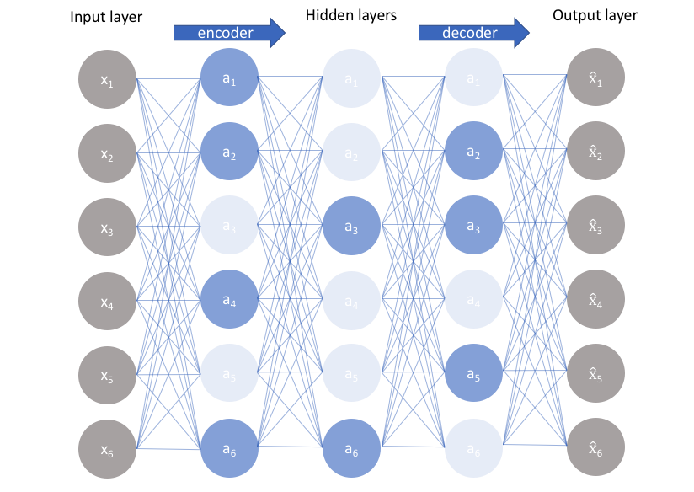

Sparse autoencoders
Construct a loss function to penalize activations the network.
L1 Regularization: Penalize the absolute value of the vector of activations a in layer h for observation I
KL divergence: Use cross-entropy between average activation and desired activation
https://www.jeremyjordan.me/autoencoders/

Slide 17
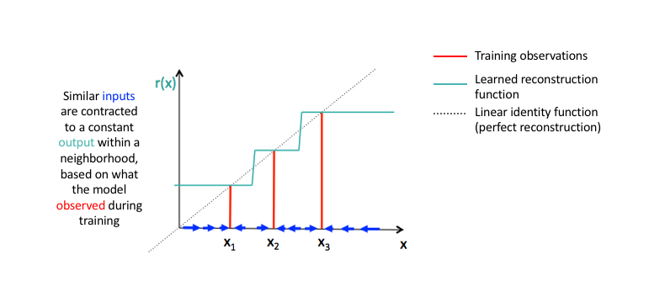

Contractive autoencoders
Arrange for similar inputs to have similar activations.
I.e., the derivative of the hidden layer activations are small with respect to the input.
Denoising autoencoders make the reconstruction function (encoder+decoder) resist small perturbations of the input
Contractive autoencoders make the feature extraction function (ie. encoder) resist infinitesimal perturbations of the input.
https://www.jeremyjordan.me/autoencoders/

Slide 18
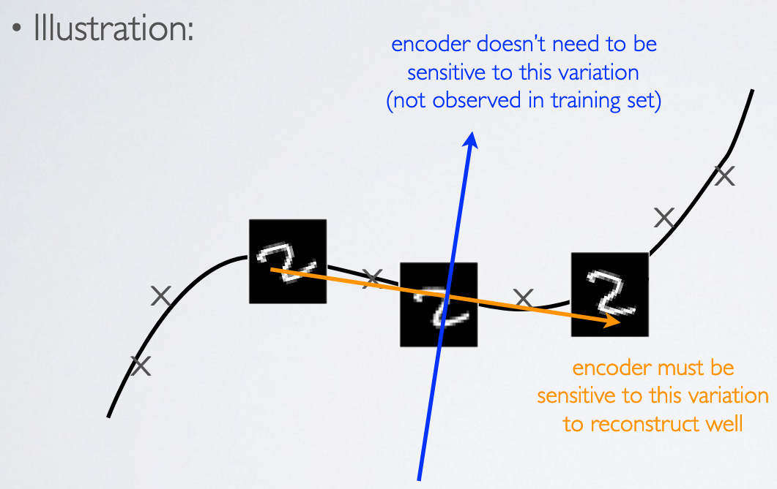
Contractive autoencoders
Contractive autoencoders make the feature extraction function (ie. encoder) resist infinitesimal perturbations of the input.
https://ift6266h17.files.wordpress.com/2017/03/14_autoencoders.pdf

Slide 19
Autoencoders
Both the denoising and contractive autoencoder can perform well
Advantage of denoising autoencoder : simpler to implement-requires adding one or two lines of code to regular autoencoder-no need to compute Jacobian of hidden layer
Advantage of contractive autoencoder : gradient is deterministic -can use second order optimizers (conjugate gradient, LBFGS, etc.)-might be more stable than denoising autoencoder, which uses a sampled gradient
To learn more on contractive autoencoders:
Contractive Auto-Encoders: Explicit Invariance During Feature Extraction. Salah Rifai, Pascal Vincent, Xavier Muller, Xavier Glorot et Yoshua Bengio, 2011.
https://ift6266h17.files.wordpress.com/2017/03/14_autoencoders.pdf

Slide 20
Examples of AutoEncoders***
https://blog.keras.io/building-autoencoders-in-keras.html
MLP-based AutoEncoders
Convolutional AutoEncoders
Application to image denoising
Sequence-to-sequence autoencoder
Variational autoencoder (VAE)
learning the parameters of a probability distribution modeling your data.
A generative model

